Slide 1




OROMAKINDE OLUSOLA MARGARET
CYBER SECURITY
"PHISHING AWARENESS TRAINING: PROTECTING YOURSELF AND YOUR ORGANIZATION"
LEARN MORE

Slide 2
"PHISHING AWARENESS TRAINING: PROTECTING YOURSELF AND YOUR ORGANIZATION"
"A COMPREHENSIVE GUIDE TO RECOGNIZING AND AVOIDING PHISHING ATTACKS"
OROMAKINDE OLUSOLA MARGARET

Slide 3
CYBER
SECURITY
In today's digital age, cybersecurity is crucial due to increasing cyber threats. Prioritizing online security through strong passwords, multi-factor authentication, and vigilance against phishing attacks helps protect sensitive information and privacy. Proactive cybersecurity measures are recommended over reactive approaches.

Slide 4
INTRODUCTION
Phishing is a type of cyber attack where attackers try to trick individuals into revealing sensitive information, such as login credentials or financial information.
- Examples: Email, phone, or text message scams
Phishing attacks can be launched through various channels, including email, phone, text message, and social media, and can have serious consequences, including financial loss, identity theft, and compromised security."

Slide 5
OVERVIEW
Statistics:
Phishing attacks are on the rise, with millions of attacks reported every year. According to recent statistics, phishing attacks account for over 90% of data breaches.
Consequences:
Phishing attacks can lead to financial loss, reputational damage, and compromised security. Individuals and organizations must be aware of the risks and take steps to protect themselves.

Slide 6
EVOLUTION
The Evolution of Phishing: From Early Days to Recent Trends
Early Days of Phishing (Late 1990s - Early 2000s)
Phishing originated in the late 1990s, with attackers using email scams to trick users into revealing sensitive information. These early phishing attacks often involved generic emails claiming to be from legitimate companies, such as banks or online services. Attackers would ask recipients to provide login credentials, financial information, or other sensitive data.

Slide 7
Email Scams and Fake Websites
As phishing evolved, attackers began creating fake websites that mimicked legitimate sites. These fake websites would ask users to enter sensitive information, which would then be stolen by the attackers. Email scams continued to be a popular phishing tactic, with attackers using tactics like urgency and fear to trick users into taking action.

Slide 8
EVOLUTION OF PHISHING (MID 2000S - 2010S)
As users became more aware of phishing attacks, attackers adapted their tactics. This led to the development of:
1. Social Engineering: Attackers began using psychological manipulation to build trust with their victims. This included using pretexting, baiting, and quid pro quo tactics to trick users into revealing sensitive information.

Slide 9
2. Spear Phishing: Attackers started targeting specific individuals or groups with tailored phishing attacks. These attacks were more sophisticated and often used information gathered from social media or other online sources.
3. Whaling: Attackers targeted high-profile individuals, such as executives or celebrities, with sophisticated phishing attacks. These attacks often used personalized information and tactics to build trust with the victim.

Slide 10
RECENT TRENDS (2010S - PRESENT)
Phishing continues to evolve, with attackers exploiting new channels and technologies. Recent trends include:
1. Phishing via Social Media: Attackers use social media platforms to launch phishing attacks, often using direct messages or posts to trick users into revealing sensitive information.
2. Mobile Device Phishing: Attackers target mobile devices with phishing attacks, often using SMS or mobile apps to trick users into revealing sensitive information.

Slide 11
3. IoT Phishing: As the Internet of Things (IoT) grows, attackers are exploring new ways to exploit connected devices. This includes using IoT devices to launch phishing attacks or steal sensitive information.
Today, phishing remains a significant threat to individuals and organizations. Attackers continue to adapt their tactics, making it essential to stay vigilant and educated on the latest phishing threats.

Slide 12
OVERVIEW OF PHISHING TACTICS AND TECHNIQUES
some common methods of Tactics and Techniques include:
Deception: Attackers disguise themselves as trustworthy entities to gain victim trust.
Urgency: Attackers create a sense of urgency to prompt victims into taking action.
Emotional Manipulation: Attackers exploit emotions like fear, greed, or curiosity to influence victim decisions.

Slide 13
SOCIAL ENGINEERING PRINCIPLES
Social engineering is a key component of phishing attacks. Attackers use various principles to manipulate victims, including:
Building Trust: Attackers establish credibility by using familiar logos, jargon, or pretending to be a trusted individual.
Creating Urgency: Attackers create a sense of urgency to prompt victims into taking action without thinking critically.
Exploiting Emotions: Attackers use emotional triggers like fear, excitement, or curiosity to influence victim decisions.

Slide 14
RECOGNIZING PHISHING EMAILS
COMMON PHISHING ATTACK VECTORS
Phishing attacks can be launched through various channels, including:
Email: Attackers send phishing emails that appear to be from legitimate sources, often with malicious links or attachments.
Phone: Attackers use phone calls to trick victims into revealing sensitive information or performing certain actions.

Slide 15
Text Messages (SMS): Attackers send phishing text messages that appear to be from legitimate sources, often with malicious links or requests for sensitive information.
Social Media: Attackers use social media platforms to launch phishing attacks, often through direct messages or posts that appear to be from legitimate sources.
These vectors are often used in combination with social engineering principles to increase the effectiveness of phishing attacks.

Slide 16
EXAMPLES AND CASE STUDY OF PHISHING
Example 1: Fake Bank Email
Email claims to be from a bank, stating that the recipient's account has been compromised.
The email asks the recipient to click on a link to verify their account information.
Suspicious elements:
Generic greeting (e.g., "Dear customer")
Urgent tone
Link to a suspicious website

Slide 17
Example 2: Phishing Email with Malicious Attachment
Email claims to be from a legitimate company, offering a job opportunity or business proposal.
The email includes a malicious attachment that installs malware when opened.
Suspicious elements:
Unsolicited job offer or proposal
Attachment from an unknown sender

Slide 18
Example 3: Spear Phishing Email
Email appears to be from a colleague or manager, requesting sensitive information or action.
The email uses the recipient's name and references a specific project or tasks
Suspicious elements:
Unusual request for sensitive information
Lack of personal touch or tone inconsistent with the supposed sender

Slide 19
CASE STUDY
Case Study:
A company received an email that appeared to be from the CEO, requesting that an employee purchase gift cards and send them to a specific address. The email used the CEO's name and tone, but the employee noticed that the email was sent from a personal email address rather than the company's domain. The employee verified with the CEO, who confirmed that the email was a phishing attempt.
These examples illustrate common phishing tactics and the importance of being cautious when receiving unsolicited emails or requests for sensitive information.

Slide 20
Fake websites are designed to deceive users into revealing sensitive information or installing malware. Characteristics of fake websites include:
Similar domain name: Fake websites often have domain names similar to legitimate sites.
Poor design: Fake websites may have poor design, grammar, or spelling mistakes.
Requests for sensitive information: Fake websites may ask for login credentials, financial information, or other sensitive data.
Unusual URL or SSL certificate: Fake websites may have unusual URLs or SSL certificate issues.
FAKE WEBSITES

Slide 21
Types of Fake Websites
Phishing websites: Designed to steal sensitive information.
Malware websites: Designed to install malware on user's device.
Scam websites: Designed to deceive users into making purchases or revealing financial information.
How to Identify Fake Websites
Verify domain name: Check if the domain name is legitimate.
Check for HTTPS: Ensure the website has a valid SSL certificate.
Look for red flags: Be cautious of websites with poor design, grammar, or spelling mistakes.
Use website reputation tools: Utilize tools to check website reputation and safety.

Slide 22
SOCIAL ENGINEERING TACTICS
Social Engineering Tactics
Social engineering tactics are used to manipulate individuals into revealing sensitive information or performing certain actions.
Common tactics include:
Pretexting: Creating a fake scenario to gain trust and obtain sensitive information.
Baiting: Offering something in exchange for sensitive information or access.

Slide 23
Quid Pro Quo: Offering a service or benefit in exchange for sensitive information or access.
Authority: Impersonating someone in authority to gain trust and compliance.
Scarcity: Creating a sense of urgency to prompt action without thinking critically.
Social Proof: Using fake social proof (e.g., fake reviews, testimonials) to build credibility.
These tactics are often used in phishing attacks, phone scams, and other types of cyber attacks to exploit human psychology and gain unauthorized access to sensitive information.

Slide 24
Best Practices to Stay Safe Online
1. Verify sender information: Be cautious with emails or messages from unknown senders.
2. Use strong passwords: Use unique and complex passwords for all accounts.
3. Enable 2FA: Add an extra layer of security with two-factor authentication.
4. Keep software up-to-date: Regularly update operating systems, browsers, and apps.

Slide 25
5. Be cautious with links and attachments: Avoid suspicious links and attachments from unknown sources.
6. Use antivirus software: Install and regularly update antivirus software.
7. Use a VPN: Consider using a virtual private network (VPN) for added security.
Stay vigilant and stay safe!

Slide 26
APPLICATION AND IMPLEMENTATION
Applying Phishing Awareness in Daily Life and at Work*
Phishing awareness is crucial in both personal and professional settings. Here's how to apply phishing awareness in daily life and at work:
Personal Life:
1. Be cautious with emails: Be wary of suspicious emails, especially those asking for sensitive information.
2. Verify sender information: Check the sender's email address to ensure it's legitimate.

Slide 27
3. Avoid suspicious links: Don't click on links from unknown senders or those that seem suspicious.
4. Use strong passwords: Use unique and complex passwords for all accounts.
5. Enable 2FA: Add an extra layer of security with two-factor authentication.
6. Keep software up-to-date: Regularly update operating systems, browsers, and apps.
7. Use antivirus software: Install and regularly update antivirus software.

Slide 28
At Work:
1. Employee training: Provide regular phishing awareness training for employees.
2. Email filtering: Implement email filtering systems to block suspicious emails.
3. Verify requests: Verify requests for sensitive information or financial transactions.
4. Use secure communication channels: Use secure communication channels, such as encrypted email or messaging apps

Slide 29
5. Incident response plan: Establish an incident response plan in case of a phishing attack.
6. Regular security updates: Regularly update security software and systems.
7. Reporting suspicious activity: Encourage employees to report suspicious activity.
Best Practices:
1. Stay informed: Stay up-to-date with the latest phishing tactics and trends.
2. Be vigilant: Be cautious when receiving unsolicited emails or requests for sensitive information.

Slide 30
3. Use technology: Utilize technology, such as email filtering and antivirus software, to help prevent phishing attacks.
4. Report incidents: Report phishing incidents to the relevant authorities.
By applying these best practices, individuals and organizations can significantly reduce the risk of falling victim to phishing attacks.

Slide 31
KEY OBSERVATIONS
Key Observations
As we navigate the complex landscape of phishing attacks, several key observations emerge:
1. Phishing attacks are becoming more sophisticated: Attackers are continually evolving their tactics, making it increasingly challenging to detect and prevent phishing attacks.
2. Human psychology plays a significant role: Phishing attacks often exploit human emotions, such as fear, greed, and curiosity, to trick individuals into revealing sensitive information.

Slide 32
3. Employee education is crucial: Educating employees on phishing awareness and prevention is essential in preventing phishing attacks in the workplace.
4. Technology alone is not enough: While technology, such as email filtering and antivirus software, can help prevent phishing attacks, it is not a foolproof solution.
5. Vigilance is key: Staying vigilant and being cautious when receiving unsolicited emails or requests for sensitive information is critical in preventing phishing attacks.

Slide 33
6. Phishing attacks can have severe consequences: Phishing attacks can result in significant financial losses, reputational damage, and compromised security.
By understanding these key observations, individuals and organizations can take proactive steps to prevent phishing attacks and protect themselves against these threats.

Slide 34
EXAMPLES AND CASE STUDIES
Real-World Examples of Phishing and Facebook Phishing Scam (2013-2015): A Lithuanian man, Evaldas Rimasauskas, sent phishing emails to employees of Google and Facebook, impersonating a Taiwanese hardware manufacturer. The attackers successfully tricked the companies into transferring over $100 million in funds to their bank accounts.
2. Uber Phishing Attack (2016): Hackers breached Uber's network by phishing an employee's credentials.

Slide 35
The attackers accessed sensitive information, including names, email addresses, and phone numbers of 57 million Uber users and drivers3. CNA Insurance Phishing Attack (2021): CNA Insurance paid a $40 million ransom after a phishing attack compromised their systems. The attackers used phishing emails to gain access to the company's network and deploy ransomware.
Analysis of Successful Phishing Attacks
Successful phishing attacks often exploit human psychology and rely on social engineering tactics. Attackers may use:

Slide 36
1. Spear phishing: Targeted phishing attacks that use personalized information to build trust with the victim.2. Urgency: Creating a sense of urgency to prompt the victim into taking action without thinking critically.
3. Authority: Impersonating someone in authority to gain trust and compliance.
Lessons Learned
1. Employee education: Educating employees on phishing awareness and prevention is crucial in preventing phishing attacks.

Slide 37
2. Multi-factor authentication: Implementing multi-factor authentication can help prevent phishing attacks from compromising sensitive information.
3. Incident response: Having an incident response plan in place can help minimize the damage caused by a phishing attack.
Examples of Effective Phishing Awareness Training Programs
1. Phishing simulation: Conducting phishing simulations to test employees' awareness and preparedness.
2. Regular training sessions: Providing regular training sessions on phishing awareness and prevention.

Slide 38
3. Interactive training: Using interactive training methods, such as videos and quizzes, to engage employees and improve their understanding of phishing attacks.
4. Reporting mechanisms: Establishing reporting mechanisms for employees to report suspicious emails or activity.
Effective phishing awareness training programs can help reduce the risk of phishing attacks by educating employees on how to identify and report suspicious activity.

Slide 39
RECOMMENDATIONS
Recommendations for Enhancing Phishing Defense
To protect against phishing attacks, organizations should consider the following recommendations:
1. Conduct Regular Phishing Awareness Training
Provide regular training sessions for employees on phishing awareness and prevention.
Use interactive training methods, such as simulations and quizzes, to engage employees and improve their understanding of phishing attacks.
Encourage employees to report suspicious emails or activity.

Slide 40
2. Implement Robust Security Measures
Install and regularly update firewalls, antivirus software, and intrusion detection systems to prevent phishing attacks.
Use email filtering systems to block suspicious emails and attachments.
Implement multi-factor authentication to add an extra layer of security.
3. Encourage a Culture of Security Awareness
Foster a culture of security awareness within the organization by promoting best practices and encouraging employees to take ownership of security.

Slide 41
Encourage employees to report security incidents and near-misses.
Recognize and reward employees who demonstrate good security practices.
4. Monitor and Update Security Systems
Regularly monitor security systems and update them as needed to stay ahead of emerging threats.
Conduct regular security audits to identify vulnerabilities and address them.
Stay informed about the latest phishing tactics and trends.

Slide 42
5. Develop an Incident Response Plan
Develop an incident response plan to quickly respond to phishing attacks and minimize damage.
Identify key stakeholders and their roles in responding to phishing attacks.
Regularly test and update the incident response plan.
By implementing these recommendations, organizations can significantly reduce the risk of phishing attacks and protect their sensitive information.

Slide 43
CONCLUSION
Phishing awareness is essential for protecting individuals and organizations
Regular training and education can help prevent phishing attacks
Stay vigilant and report suspicious activity
Articles and blogs on phishing awareness
Online training courses and webinars
- Security software and tools

Slide 44
Additional Ideas:
Include interactive elements, such as quizzes, games, or simulations, to engage participants and reinforce learning.
Use images, videos, and real-world examples to illustrate key concepts and make the training more relatable.
Provide a comprehensive guide or handbook for participants to reference after the training.
Consider offering a certification or badge for participants who complete the training and demonstrate their knowledge

Slide 45
ANDROID FORENSICS INVESTIGATION
This report documents the forensic analysis of an android mobile device image to extract potential digital evidence. The objective was to retrieve and analyse user activity, information communication records, application usage, files and any deleted content to asses the state of the device and provide actionable conclusions.

Slide 46
METHODOLOGY
The forensic process followed the structured approach:
Acquisition: The android image was provided for this report
Examination: Autopsy was used to parse the file system, extract data and identify artifacts if interest.
Analysis: Extracted data was interpreted to reveal insights into the user's behaviour, call logs, SMS, App usage and stored media.
Documentations: Screenshots and structured evidence were compiled to support the findings.

Slide 47
FINDINGS
SMS MESSAGES
Call logs
Tot call entries: 28
Top contacted number: 08032111669
Last call made: 2024-03-17. 16:36:28 PDT

Slide 48
APPLICATION USAGE
There are no history of application usage but I have the following applications installed on the device:
WhatsApp
Wallet Trust - for Crypto
Square up Cash
YouTube and
Twitter

Slide 49
FILES AND IMAGES
Total Images Found: 200
Recovered Deleted Image: 1
Suspicious File Name: No Suspicious file name found.

Slide 50
BROWSER HISTORY, DELETED FILES AND CRYPTO WALLET
Browsers Deleted: Chrome, Nairaland, Businessday
Top sites visited: https://goggle.com, https://nairaland.com, https://businessday.ng
Search Queries: "How to know if EFCC is tracking you", "New and latest investment scam format", "Scared of being arrested by EFCC"
Deleted Files: There are no deleted file except for a single image found in the cache.
Crypto Wallet: There are no single crypto wallet found in installed applications but can't be viewed.

Slide 51
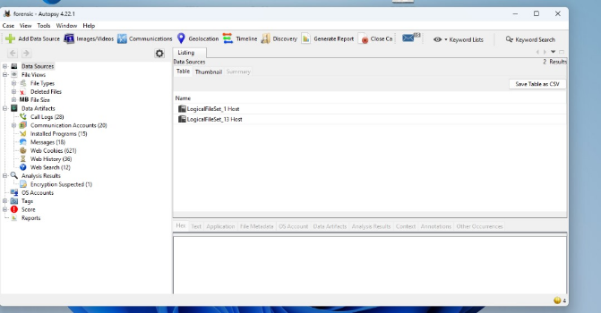
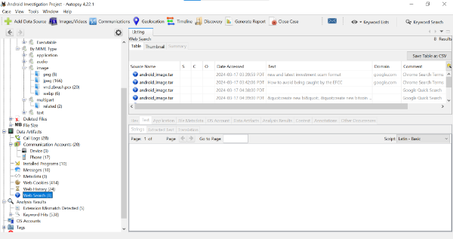
SCREENSHOTS

Slide 52
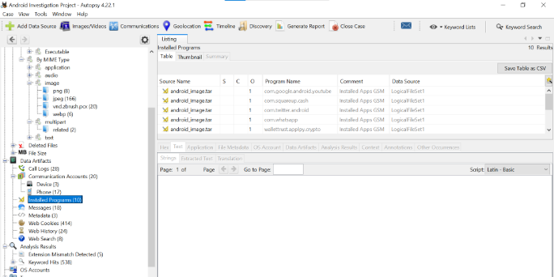
SCREENSHOTS

Slide 53
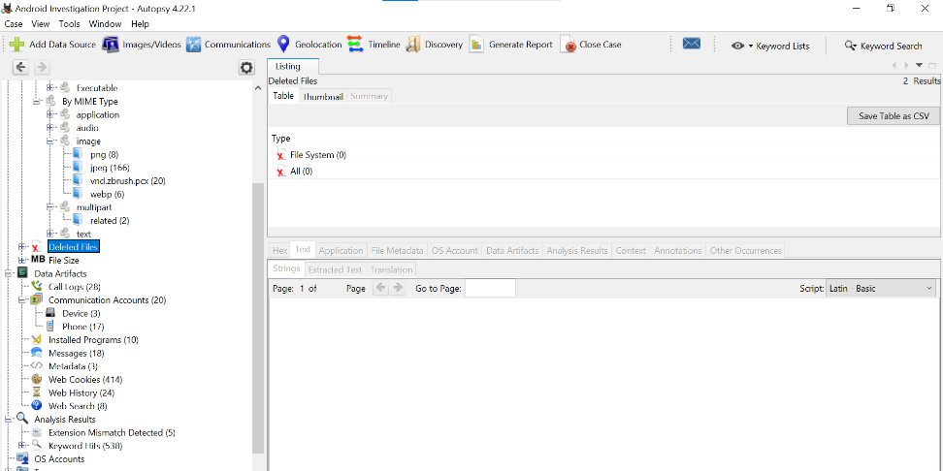
SCREENSHOTS

